Slide 1

Presented by
Hari

Slide 2
Agenda
Spring Boot
Why should we use Spring Boot Framework
Spring Boot Architecture
Spring Boot Features
Advantages of Spring Boot
Difference between Spring , Spring Boot and Spring MVC
Spring Annotations
Proof of Concept

Slide 3
Spring:
The Spring Framework (Spring) is an open-source application framework that provides infrastructure support for developing Java applications. One of the most popular Java Enterprise Edition (Java EE) frameworks, Spring helps developers create high performing applications using plain old Java objects (POJOs).
Spring Boot:
Spring boot is a light-weight framework that is majorly used to write microservices in Java.
Spring boot was developed by the PIVOTAL team.
Spring Boot is a project that is built on the top of the Spring Framework. It provides an easier and faster way to set up, configure, and run both simple and web-based applications.
It is a Spring module that provides the RAD (Rapid Application Development) feature to the Spring Framework.
It is used to create a stand-alone Spring-based application that you can just run because it needs minimal Spring configuration.

Slide 4
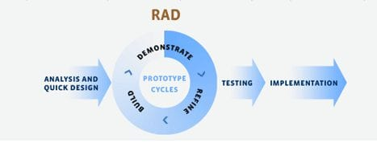
RAD:
Rapid Application Development (RAD) is a form of agile software development methodology that prioritizes rapid prototype releases and iterations.
Unlike the Waterfall method, RAD emphasizes the use of software and user feedback over strict planning and requirements recording.

Slide 5
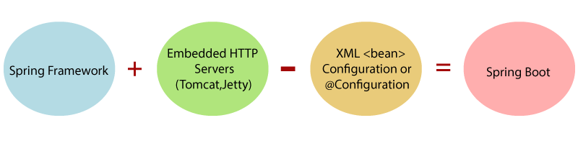
Spring Boot:
Why should we use Spring Boot Framework
We should use Spring Boot Framework because:
The dependency injection approach is used in Spring Boot.
It contains powerful database transaction management capabilities.
It simplifies integration with other Java frameworks like JPA/Hibernate ORM, Struts, etc.
It reduces the cost and development time of the application.

Slide 6
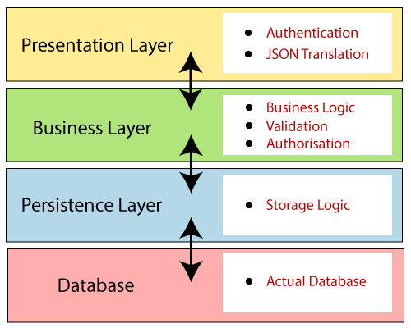
Spring Boot Architecture:
Presentation Layer: The presentation layer handles the HTTP requests, translates the JSON parameter to object, and authenticates the request and transfer it to the business layer .
Business Layer: The business layer handles all the business logic.
It consists of service classes and uses services provided by data access layers. It also performs authorization and validation.
Persistence Layer: The persistence layer contains all the storage logic and translates business objects from and to database rows.
Database Layer: In the database layer, CRUD (create, retrieve, update, delete) operations are performed.

Slide 7
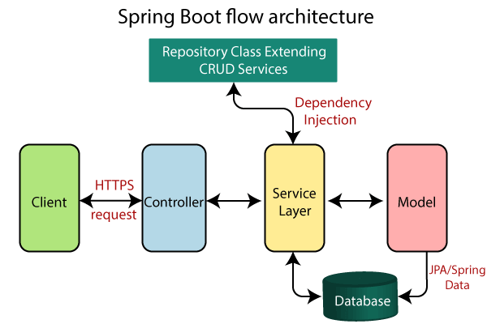

Slide 8
Explanation of Spring Boot Flow Architecture :
Now we have validator classes, view classes, and utility classes.
Spring Boot uses all the modules of Spring-like Spring MVC, Spring Data, etc. The architecture of Spring Boot is the same as the architecture of Spring MVC, except one thing: there is no need for DAO and DAOImpl classes in Spring boot.
Creates a data access layer and performs CRUD operation.
The client makes the HTTP requests (PUT or GET).
The request goes to the controller, and the controller maps that request and handles it. After that, it calls the service logic if required.
In the service layer, all the business logic performs. It performs the logic on the data that is mapped to JPA with model classes.
A JSP page is returned to the user if no error occurred.

Slide 9
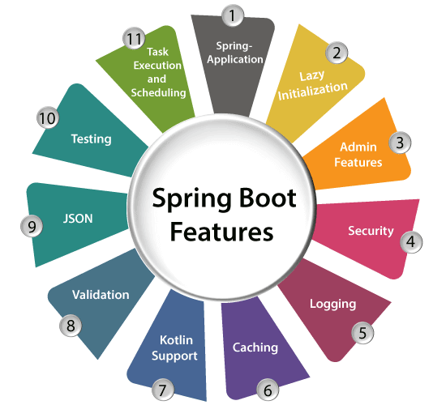
Spring Boot Features

Slide 10
Advantages of Spring Boot
It creates stand-alone Spring applications that can be started using Java -jar.
It tests web applications easily with the help of different Embedded HTTP servers such as Tomcat, Jetty, etc. We don't need to deploy WAR files.
It provides opinionated 'starter' POMs to simplify our Maven configuration.
It provides production-ready features such as metrics, health checks, and externalized configuration.
There is no requirement for XML configuration.
It offers a CLI tool for developing and testing the Spring Boot application.
It offers the number of plug-ins.
It also minimizes writing multiple boilerplate codes (the code that has to be included in many places with little or no alteration), XML configuration, and annotations.
It increases productivity and reduces development time.

Slide 11
Spring | Spring Boot
Spring Framework is a widely used Java EE framework for building applications. | Spring Boot Framework is widely used to develop REST APIs.
It aims to simplify Java EE development that makes developers more productive. | It aims to shorten the code length and provide the easiest way to develop Web Applications.
The primary feature of the Spring Framework is dependency injection. | The primary feature of Spring Boot is Autoconfiguration. It automatically configures the classes based on the requirement.
It helps to make things simpler by allowing us to develop loosely coupled applications. | It helps to create a stand-alone application with less configuration.
The developer writes a lot of code (boilerplate code) to do the minimal task. | It reduces boilerplate code.
To test the Spring project, we need to set up the sever explicitly. | Spring Boot offers embedded server such as Jetty and Tomcat, etc.
It does not provide support for an in-memory database. | It offers several plugins for working with an embedded and in-memory database such as H2.
Developers manually define dependencies for the Spring project in pom.xml. | Spring Boot comes with the concept of starter in pom.xml file that internally takes care of downloading the dependencies JARs based on Spring Boot Requirement.

Slide 12
Spring Boot | Spring MVC
Spring Boot is a module of Spring for packaging the Spring-based application with sensible defaults. | Spring MVC is a model view controller-based web framework under the Spring framework.
It provides default configurations to build Spring-powered framework. | It provides ready to use features for building a web application.
There is no need to build configuration manually. | It requires build configuration manually.
There is no requirement for a deployment descriptor. | A Deployment descriptor is required.
It avoids boilerplate code and wraps dependencies together in a single unit. | It specifies each dependency separately.
It reduces development time and increases productivity. | It takes more time to achieve the same.

Slide 13
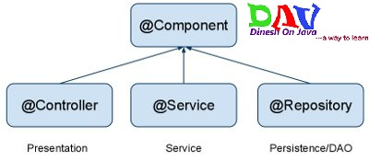
Spring Annotations:
Spring Core Annotations: There are 3 Types
Stereotype Annotation
Auto wired Annotation
Miscellaneous Annotation
Stereotype Annotation:
@Component:In component has three types
@Controller: marks the class as web controller, capable of handling
the requests.
@Service: It indicates that an annotated class is a service class.
It is Running Business Logic.
@Repository: It indicates that an annotated class is a repository,
which is an abstraction of data access and storage.

Slide 14
@Controller
@Service
@Repository
Data
Base
user
Process

Slide 15
AutoWired
@Autowired:We use @Autowired to mark the dependency which will be injected by the Spring container. It can be used with a constructor, setter or field-based injection.
@Qualifier:We use @Qualifier along with the @Autowired annotation to avoid ambiguity when we have multiple beans of the same type.
Miscellaneous Annotation
@Primary : It indicates that a bean should be given preference when multiple candidates are qualified to autowire a single-valued dependency.
@Value : It is used to inject values into variables and method arguments. We can either read spring environment variables or system variables. It also supports SpEL.
@Post Constructor : Spring calls methods annotated with @PostConstruct only once, just after the initialization of bean properties.
@Pre Destructor : A method annotated with @PreDestroy runs only once, just before Spring removes our bean from the application context.

Slide 16
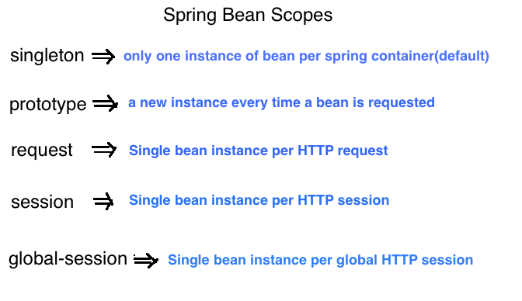
@Scope : A scope defines the runtime context within which the bean instance is available.
In Scope there are 5 types

Slide 17
Lombok Annotation:Project Lombok is a Java library tool that generates code for minimizing boilerplate code. The library replaces boilerplate code with easy-to-use annotations.
@Setter : Creates setter for all non-final properties .
@Getter : Creates getter methods for all properties .
@All arg Constructor : Generates a constructor for all properties of the class
Any @NotNull properties will have null checks .
@Required arg Constructor : Generates a constructor for all fields that are final or marked @NonNull
The constructor will throw a NullPointerException if any @NonNull fields are null val – local variables are declared final
@Hash code :Generates implementations of equals(Object other) and hashCode()
By default will use all non-static, non-transient properties
Can optionally exclude specific properties

Slide 18
Hibernate Annotation: Hibernate annotations are the newest way to define mappings without the use of XML file. You can use annotations in addition to or as a replacement of XML mapping metadata. Hibernate Annotations is the powerful way to provide the metadata for the Object and Relational Table mapping.
@Entity : It specifies that the class is an entity and is mapped to a database table.
@Table : It specifies the name of the database table to be used for mapping.
@Id : It specifies the primary key of an entity.
@Column :The Column annotation is used to specify the mapped column for a persistent property or field. If no Column annotation is specified, the default value will be applied.
@One to One : This annotation defines a single-valued association to another entity that has one-to-one multiplicity . To call one application to another application is called rest template/fing client
@One to Many : one-to-many mapping means that one row in a table is mapped to multiple rows in another table.
@Many to Many : Hibernate many to many mapping is made between two entities where one can have relation with multiple other entity instances.

Slide 19
Spring boot Application: It enables Spring Boot auto configuration and component scanning.
@Configuration : It indicates that a class is a configuration class that may contain bean definitions.
@Enable Auto Configuration : @EnableAutoConfiguration is an interface as part of org.springframework.boot.autoconfigure package.
This enables auto-configuration of your application context that is based on our needs and tries to attempt to configure beans. Mainly this autoconfiguration is decided based on your classpath and what are the jars added to the application.
@Component scan : If you have many packages or paths in your application and all of them are outside the spring boot main class will not be scanned automatically.
By using @ComponentScan annotation, we can autowire the classes from another project or another jar.

Slide 20
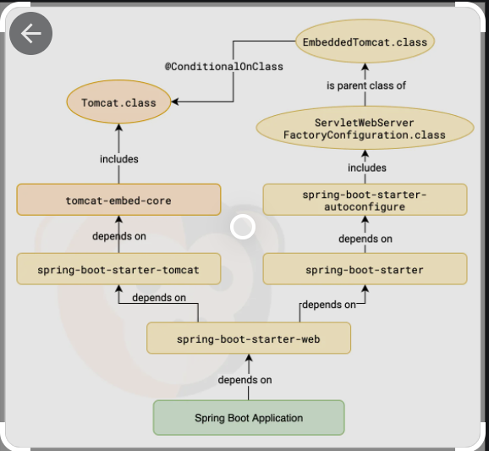
Spring Boot auto-configuration automatically configure a Spring application based on the dependencies present on the classpath. Spring Boot detects classes in the classpath and auto-configuration mechanism will ensure to create and wires necessary beans for us.

Slide 21
Rest Service Annotations:
@Rest Controller : It combination of both @controller + @Response Type.
@Request Mapping : maps HTTP request with a path to a controller method.
@Get Mapping : @GET maps to the HTTP GET method.
@Post Mapping : to create the details
@Put Mapping : to update the details.
@Delete Mapping : To delete the Unwanted details
@Patch Mapping : @PatchMapping annotation for mapping HTTP PATCH (Particular)requests onto specific handler methods.
@Request Body : allows us to retrieve the request's body. We can then return it as a String or deserialize it into a Plain Old Java Object (POJO).
@Response Body : It uses HTTP Message converters to convert the return value to HTTP response body, based on the content-type in the request HTTP header.
@Path Variable :to call the particular name or whatever may be .

Slide 22
Conditional Annotation
@Conditional : : It allows us to define custom conditions to apply to parts of our application context.Spring Boot builds on top of that and provides some pre-defined conditions , so we don’t have to implement them ourselves.
@Conditional on class : Load a bean only if a certain class is on the class path.
@Conditional on Missing class : Load a bean only if a certain class is not on the class path.
@Conditional on Bean : Some times , we might want to load a bean only if a certain other bean is available in the application context.
@Conditional on Missing bean : If we want to load a bean only if a certain other bean is not in the application context.
@Conditional on Expression : If we have a more complex condition based on multiple properties.
@Conditional on Property : If allows to load beans conditionally depending on a certain environment property.

Slide 23


Slide 24
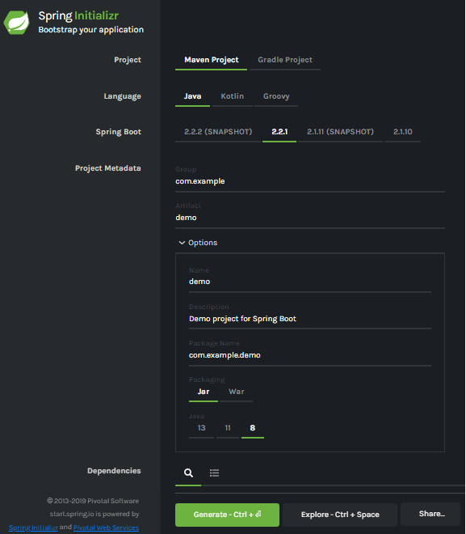
Spring Initializr
Spring Initializr is a web-based tool provided by the Pivotal Web Service. With the help of Spring Initializr, we can easily generate the structure of the Spring Boot Project. It offers extensible API for creating JVM-based projects.

Slide 25
Generating a Project
Project: It defines the kind of project. We can create either Maven Project or Gradle Project. We will create a Maven Project throughout the tutorial.
Language: Spring Initializr provides the choice among three languages Java, Kotlin, and Groovy. Java is by default selected.
Spring Boot: We can select the Spring Boot version. The latest version is 2.2.2.
Project Metadata: It contains information related to the project, such as Group, Artifact, etc. Group denotes the package name; Artifact denotes the Application name. The default Group name is com.example, and the default Artifact name is demo.
Dependencies: Dependencies are the collection of artifacts that we can add to our project.
There is another Options section that contains the following fields:
Name: It is the same as Artifact.
Description: In the description field, we can write a description of the project.
Package Name: It is also similar to the Group name.
Packaging: We can select the packing of the project. We can choose either Jar or War.
Java: We can select the JVM version which we want to use. We will use Java 8 version throughout the tutorial.
There is a Generate button. When we click on the button, it starts packing the project and downloads the Jar or War file, which you have selected.

Slide 26
Creating a Spring Boot Project
Following are the steps to create a simple Spring Boot Project.
Step 1: Open the Spring initializr https://start.spring.io.
Step 2: Provide the Group and Artifact name. We have provided Group name com.javatpoint and Artifact spring-boot-example.
Step 3: Now click on the Generate button.

Slide 27
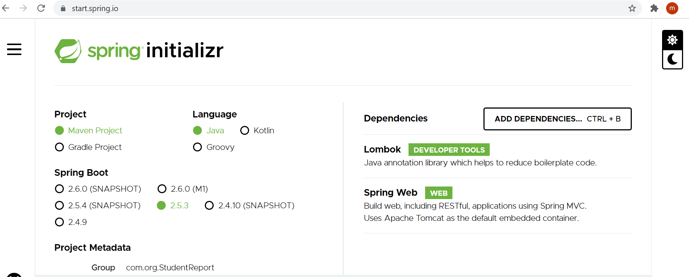

Slide 28
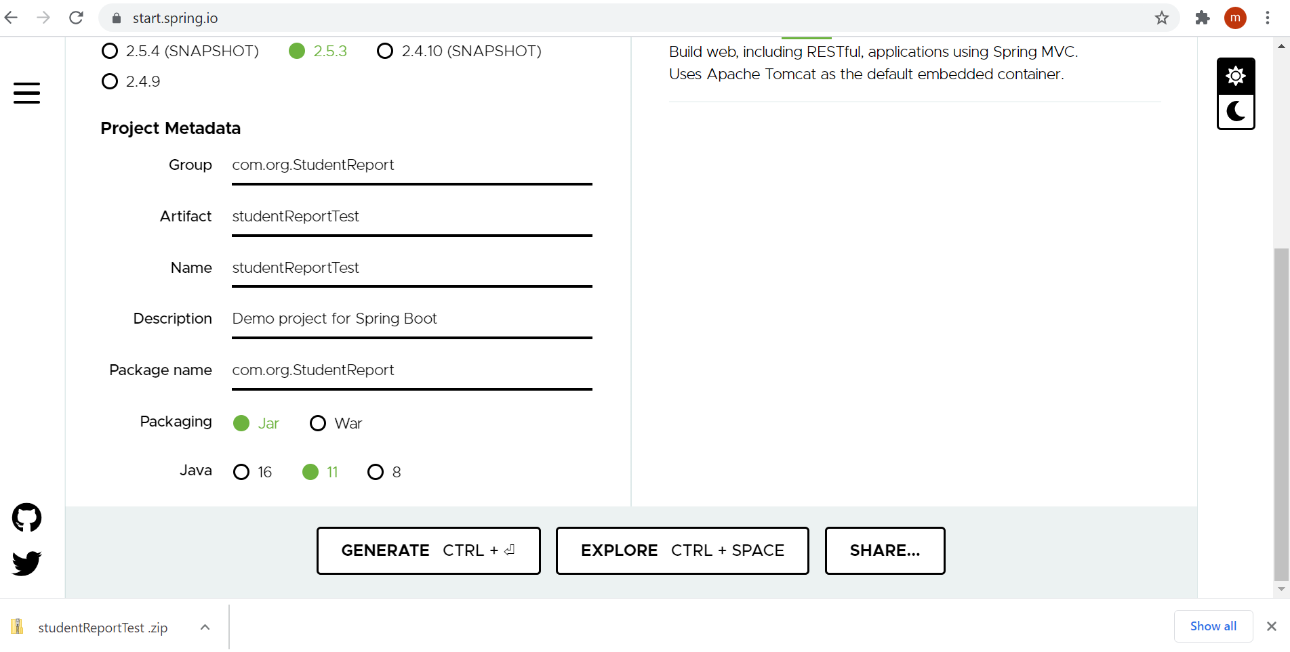

Slide 29
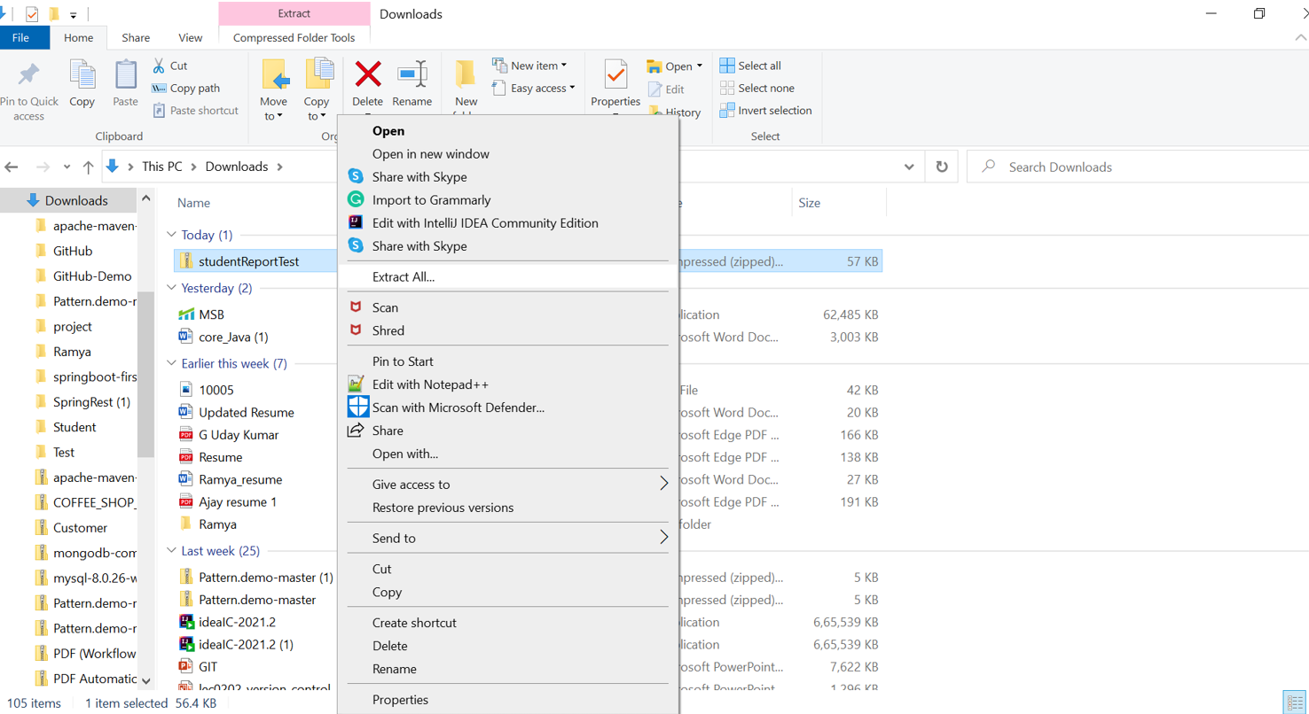

Slide 30
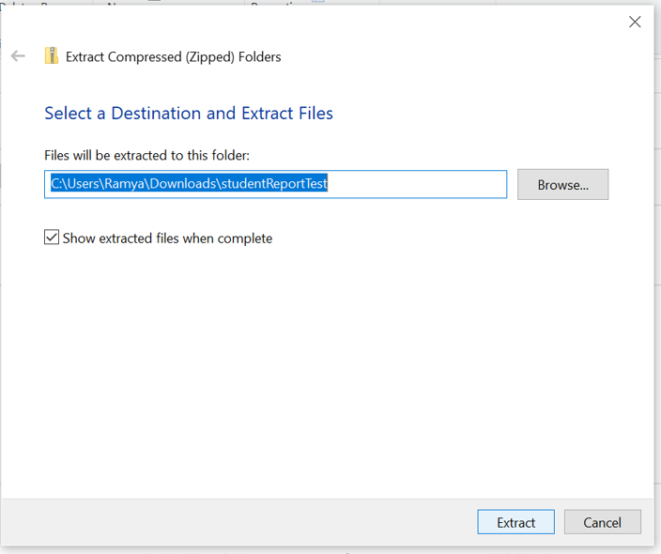

Slide 31
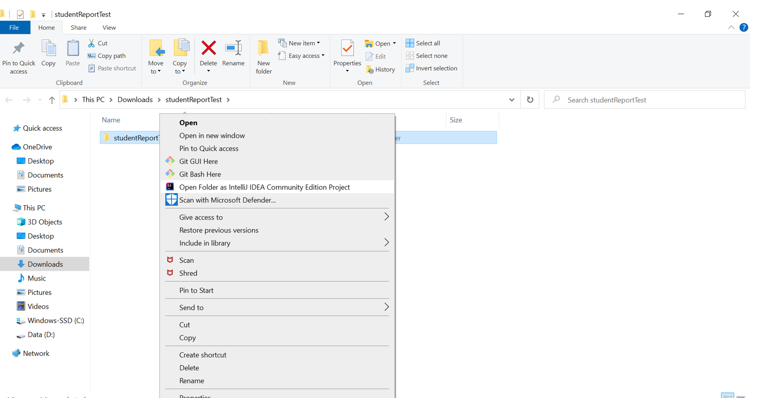

Slide 32
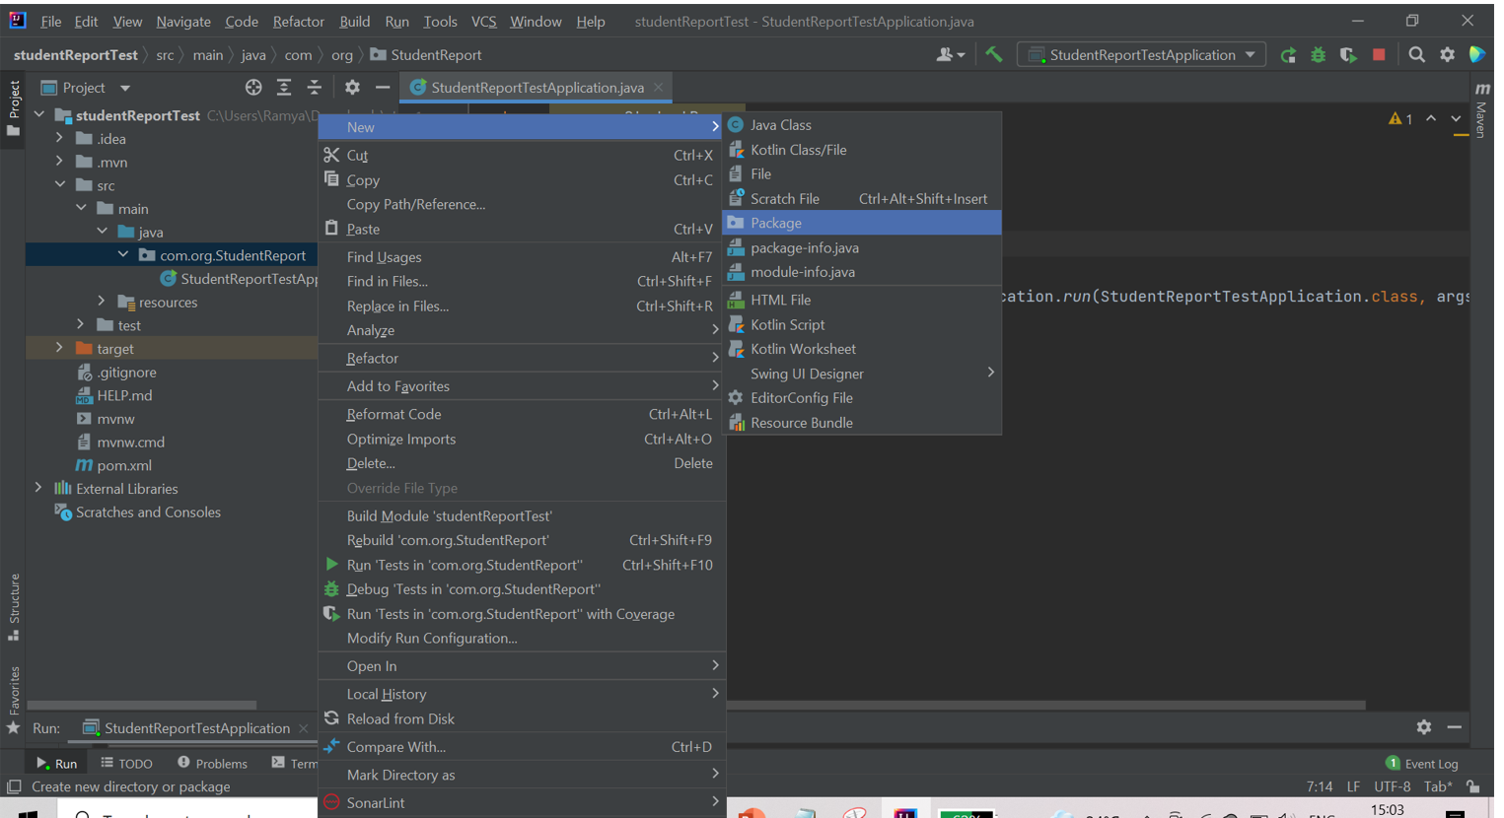

Slide 33
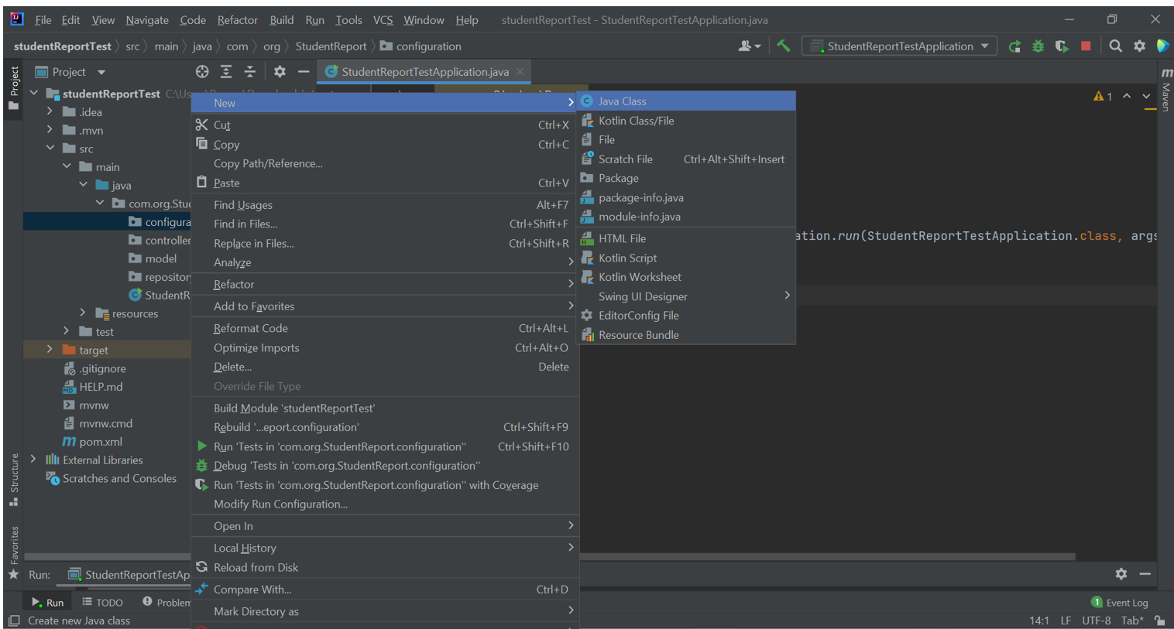

Slide 34
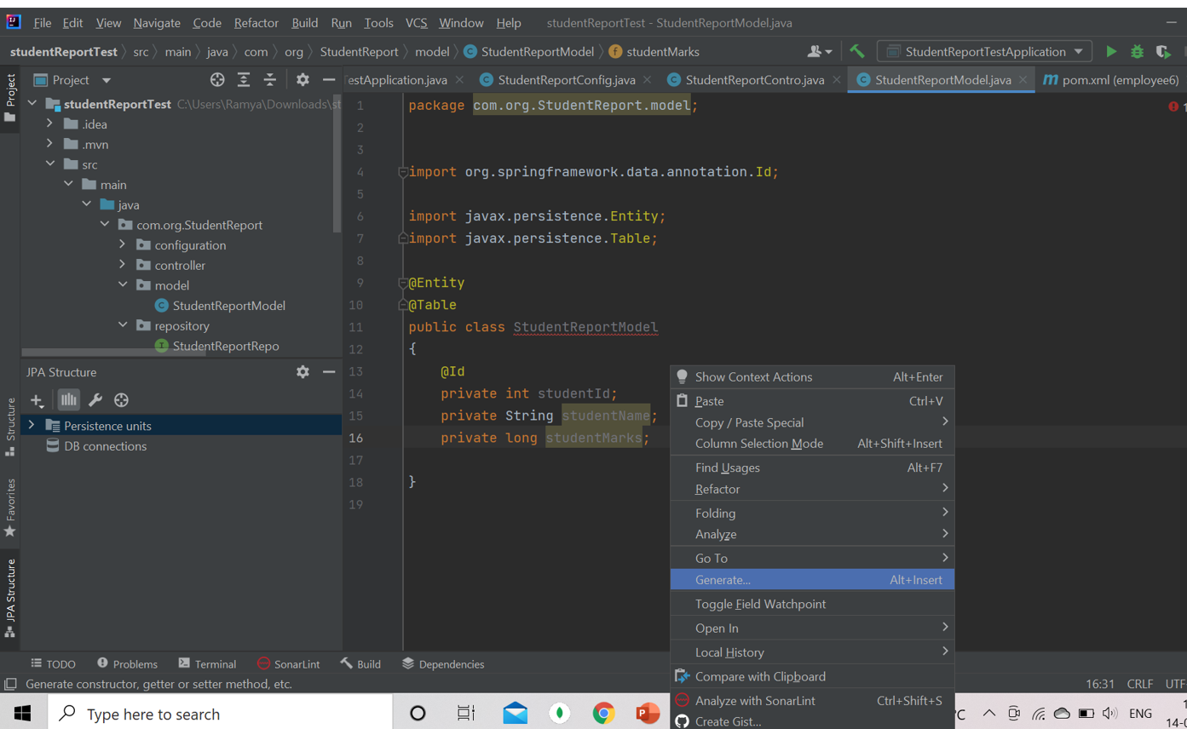

Slide 35
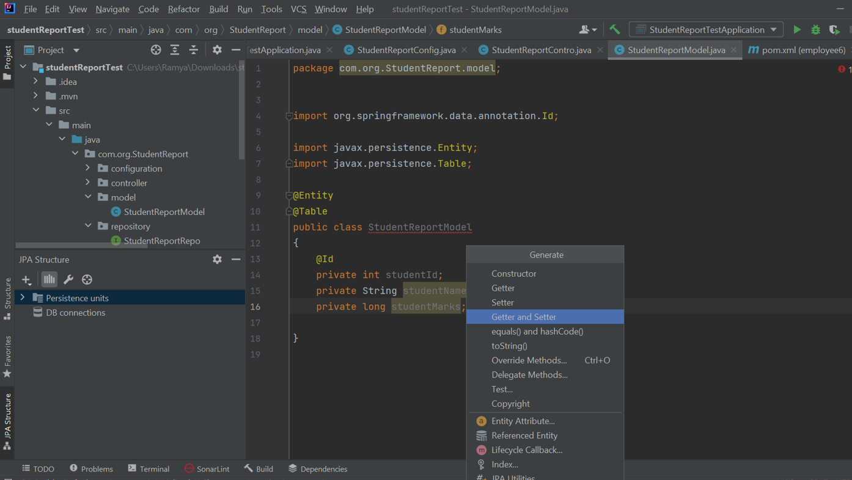

Slide 36
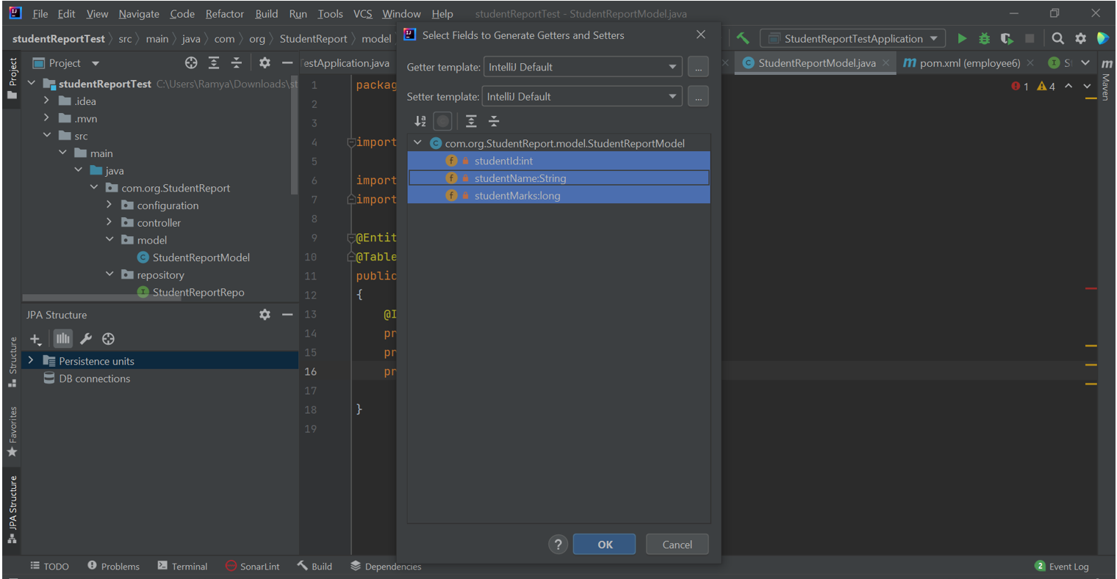

Slide 37
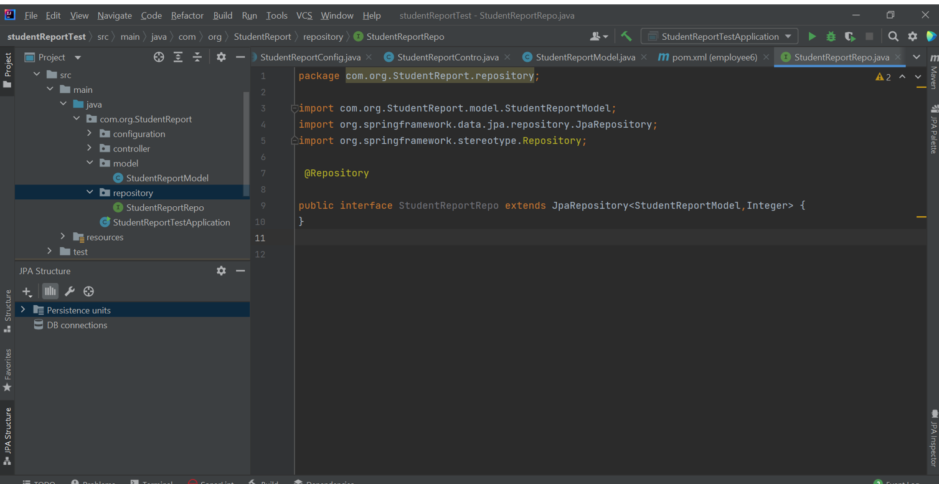

Slide 38
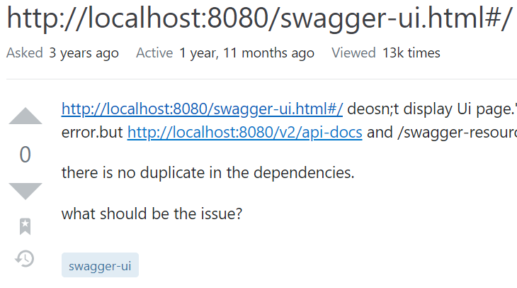

Slide 39
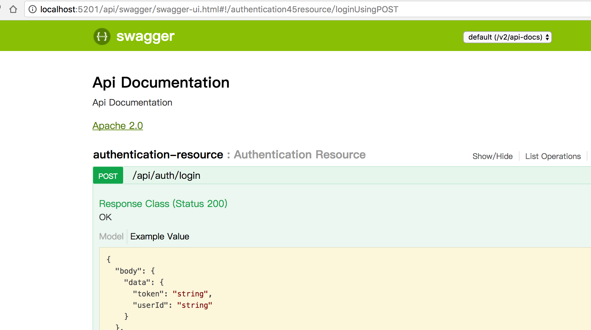

Slide 40
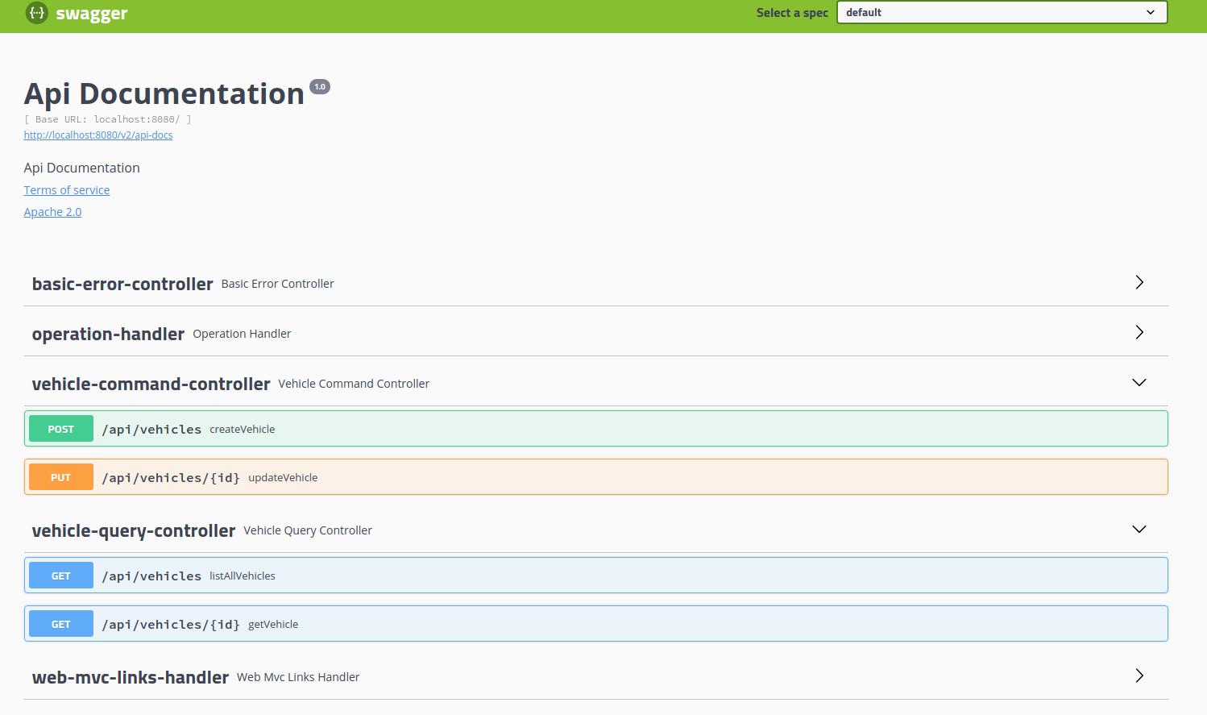

Slide 41
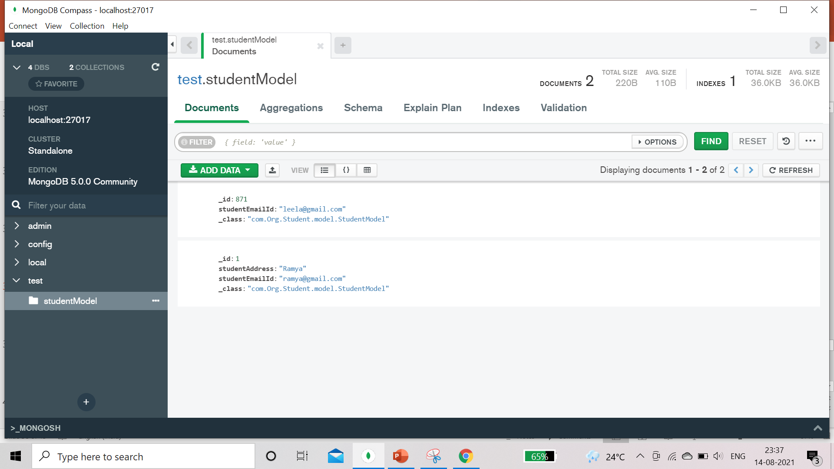

Slide 42


